Slide 1
Image Processing

Slide 2
Introduction
Visual Information transmitted in the form of digital images is a major method of communication in the modern age, but the image is often corrupted with noise.
The received image needs processing before it can be used in applications.
Image denoising involves the manipulation of the image data to produce a visually high quality image.

Slide 3
Noise Types:
Solving Gaussian Noise, (evenly distributed over signal… each pixel in noisy image is the sum of the true pixel value and a random Gaussian distributed noise value.)
Other types are:
  Salt and Pepper Noise
  Speckle Noise
  Brownian Noise

Slide 4
Technique:
Spatial Domain Filtering: Applies a mean filter on an image to smoothen it, reduces intensity variation between adjacent pixels.
Implemented using a convolution matrix, weighted sum of the values of a pixel and its neighbors.

Slide 5
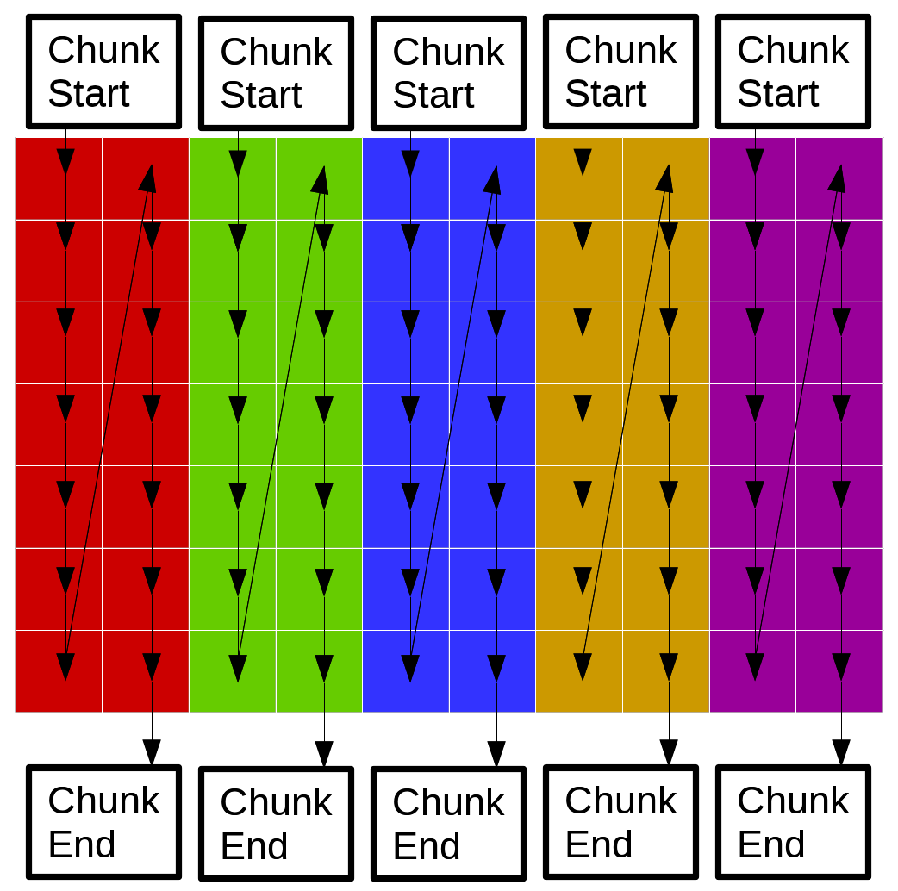
Parallel Implementation:
Instead of one thread doing the kernel for a single pixel at a time, we have several.
Let each thread handle one vertical “chunk” of the image. Converting Images into a matrix representation of their pixel color values. Both BW and RGB.
All threads use the same object
for reading pixels and the same
object for writing pixels.

Slide 6
Contention:
Chunks are width (matrix size)x2 --> threads work on pixels far away from each other.
Unlikely that the same pixel will be accessed by two threads at the same time.
They will access pixels on the same cache line (row) but effects of contention are minimal.
Tests on doing processing row wise or column wise reveal negligible difference. Thus contention due to the cache line is negligible.
Explanation: The image data structure stores pointers – contention on fetching pointers (size int) is a tiny part of actually modifying the pixel value the pointer points to. And once the pointer is fetched, contention will not arise for the rest of that pixel’s processing.
Thus it’s better not to split the source and output image into separate objects before doing the kernel (waste of time).

